Slide 1
Practical Malware Analysis
Chapter 18 : Packers and unpacking
Jungho Oh

Slide 2
Packing Programs
Packing programs help malware
Hide from antivirus software
Complicate malware analysis
Shrink the size of malicious
Most packers are easy to use and freely available
Basic static analysis is not useful on packed program

Slide 3
Packing Programs
All packers take an executable file as input and produce an executable file as output
The packed executable is
Compressed
Encrypted
Transformed
Making it harder to recognize and reverse-engineer
Most packers use a compression algorithm to compress the original executable

Slide 4
Packing Programs
Packers can pack
the entire executable (all data and resource section)
Only the code and data sections

Slide 5
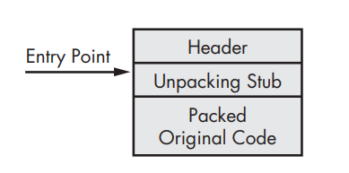
Unpacking Stub
The unpacking stub is loaded by OS, and then the unpacking stub load the original program
The code entry point points to the unpacking stub
The original program is generally stored in one or more extra sections
The unpacking stub is often small
Does not contribute the main functionality of the program

Slide 6
Unpacking Stub
The unpacking stub preforms three steps
Unpacks the original executable into memory
Resolves all of the imports of the original executable
Transfers execution to the original entry point (OEP)

Slide 7
Loader
Regular executable load
a loader reads the PE header on the disk
Loader allocates memory for each of the executable sections based on that header
copies the sections into allocated space in memory
Packed executable load
A loader reads the PE header on the disk
Loader allocates memory or the unpacking stub can create the section

Slide 8
Window loader
The window loader reads the import information
Determine which functions are needed
Fill in the addresses
The window loader cannot read import information that is packed
For packed executable, the unpacking stub resolve the import
The specific approach depends on the packer

Slide 9
Resolving Imports
Approach 1
Import only LoadLibrary and GetProcAddress
After the unpacking stub unpack the original executable, it reads the original information
call LoadLibrary for each library
Use GetProcAddress to get the address for each function
Approach 2
Keep the original import table intact
Simplest approach
Static analysis of the packed program will reveal all the original imports

Slide 10
Resolving Imports
Approach 3
Keep one import function from each DLL contained in original import table
Reveal only one function per imported library during analysis
Approach 4
Removal of all imports(including LoadLibrary and GetProcAddress)
Packer must find all the functions without using functions
Unpacking stub must be complex

Slide 11
Tail jump
Unpacking stub is complete
→ transfer execution to the OEP(original entry point)
The instruction that transfer to the OEP is refereed to as the tail jump
Jump instruction is the simplest and popular way to transfer execution
Many malicious packer also attempt to use ret or call

Slide 12
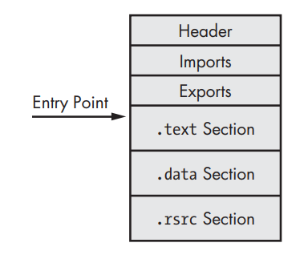
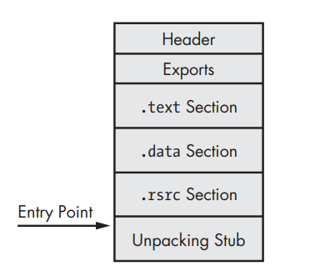
Unpacking illustrated
Original executable
Packed executable as it exists on the disk
Packed executable as it exists when it is loaded into memory
Staring point point to the unpacking stub

Slide 13
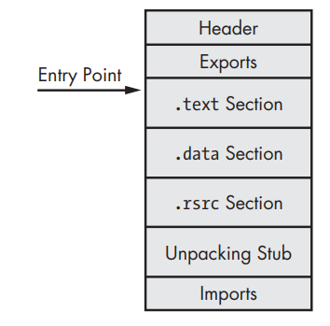
Unpacking illustrated
Fully unpacked executable
Import table has been reconstructed and starting point has been edited to point to the OEP

Slide 14
Identifying Packed Programs
The programs has few imports, and particularly if the only imports LoadLibrary and GetProcAddress
Only small amount of code is recognized by the automatic analysis
When program is opened in OllyDbg, there is a warning that the program may be packed
The program shows section names that indicate a particular packer (UPX0)
The program has abnormal section size
.text section with a Size of Raw Data of 0
Entropy Calculation
Compressed or encrypted data → high entropy
Executables that are not encrypted or compressed → low entropy
Use Packer detected tools (PEiD, Mandiant Red Curtain, Red Curtain)

Slide 15
Unpacking Options
3 options for unpacking a packed executable
Automated static unpacking
Automated dynamic unpacking
Manual dynamic unpacking
Automated unpacking techniques are faster and easier than manual dynamic unpacking
But do not always work

Slide 16
Automated static Unpacking
Automated static unpacking programs
Decompress and/ or decrypt the executable
Fastest method
best method since it does not run executable
Specific to a single packer
PE Explorer (free program) static unpacking plug-in as default
Supports NSPack, Upack, and UPX

Slide 17
Automated dynamic Unpacking
Automated dynamic unpacking programs
Run executable
Allow the unpacking stub to unpack original executable
One the original executable is unpacked, the program is written to disk
Unpacker reconstruct the original import table
Automated unpacking program must determine where unpacking stub ends and original executable begins

Slide 18
Manual dynamic Unpacking
Two common approaches to manually unpacking a program
Approach 1
Discover the packing algorithm and write a program to run it reverse
Undoes each of the step
Approach 2
Run the packed program → unpacking stub does the work, dump the process out of the memory
Manually fix up the PE header

Slide 19
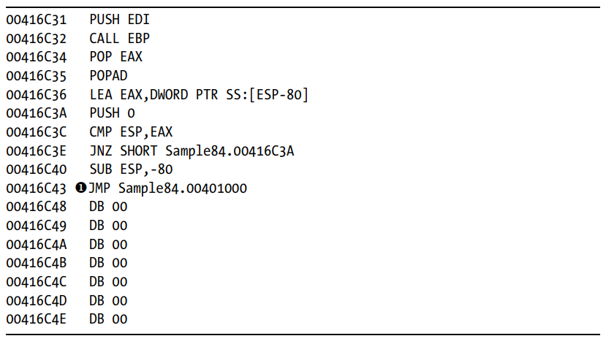
Finding OEP
There are many strategies for location the OEP(original entry point)
No single strategy will work against all packer
Strategy 1
Find the jmp instruction
① located end of the code
Links to an address that is very far
Jumps are used for conditional statements and loops, and go to address that are within a few hundred bytes
But this jump goes to an address that 0x15C43 away

Slide 20
Finding OEP
Strategy 2
Set a read breakpoint on the stack
Most functions begin with a push instruction of some sort
When the unpacking stub is complete, the address will be accessed via a pop, which will hit the breakpoint
Strategy 3
Set a breakpoints after every loop in the code
Allows to monitor each instruction being executed

Slide 21
Finding OEP
Strategy 4
Set a breakpoint on GetProcAddress
Most unpackers will use GetProcAddress to resolve the imports for the original function
Strategy 5
Set a breakpoints on function that will be called by original program
For command-line programs, wrapper calls GetVersion and GetCommandLineA very early in the process
For GUI programs, GetModuleHandleA is usually the first function to be called
Strategy 6
Run Trace option in OllyDbg
Many packer leave the .text section for the original file

Slide 22
Import Table
OllyDump and ImpRec are usually able to rebuild the import table
But sometimes this fails
Import table is actually two tables in memory
List of names or ordinals used by loader or unpacking stub
List of the addresses of all the functions are imported
When the code is running, only the second is needed
Manually rebuild the table

Slide 23
Repairing the Import Table Manually
Strategy 1
Repair the imports one at a time as encounter
Open file (without import information)
When see imported function, label that function
Strategy 2
manually rebuild the import table
If finding table of imported function is possible, then can rebuild the original import table by hand

Slide 24
Common Packers
UPX(Ultimate Packer for eXecutables)
Open source, free and easy to use
Compress the executable
Popular because high decompression speed, small size and low memory requirements
PECompact
Commercial packer designed for speed and performance
See tail jump consisting of a jump eax followed by many 0x00

Slide 25
Common Packers
ASPack
Focused on security → make it difficult to unpack programs
Use self-modifying code → difficult to set breakpoints and analyze in general
In early code, will see PUSHAD
Themida
Complicated packer with many features
Most of the features are anti-debugging and anti-analysis
Also has kernel component which make it difficult to analyze

Slide 26
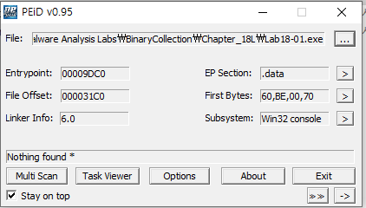
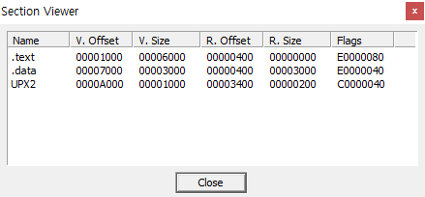
LAB 18-1
Unpack the Lab 18-01.exe
PEiD does not detect the packer
Section in the file named UPX2
UPX-like packer is being used

Slide 27
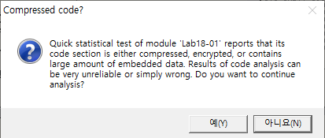
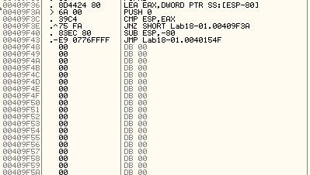
LAB 18-1
Waring for packers
This JMP transfers control to the OEP

Slide 28
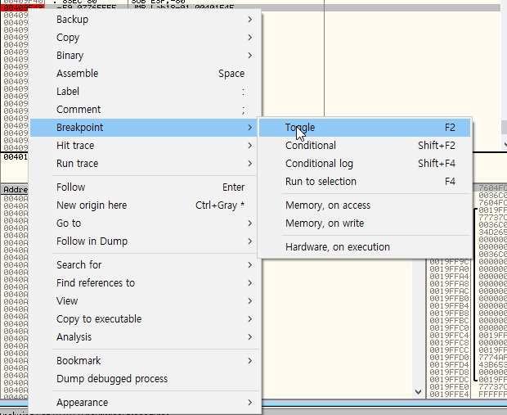
LAB 18-1
Set the break point on the tail jump

Slide 29
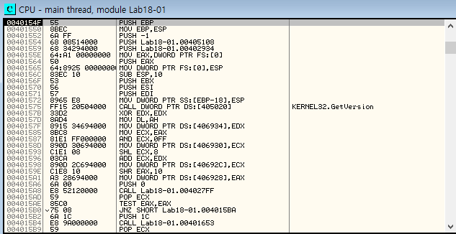
LAB 18-1

Slide 30
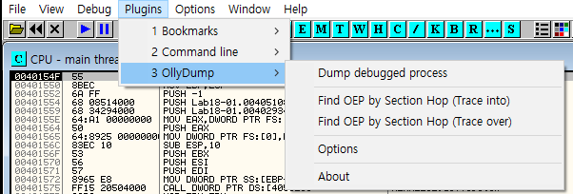
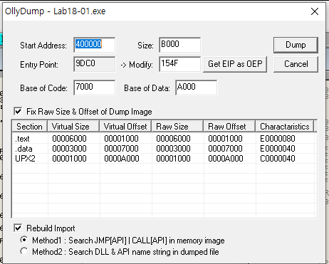
LAB 18-1
Dump the process to a disk

Slide 31
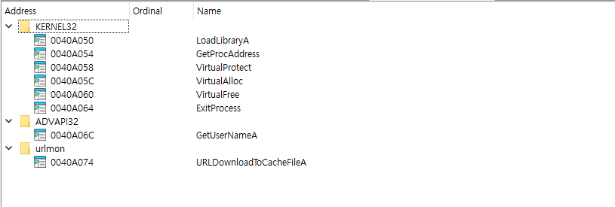
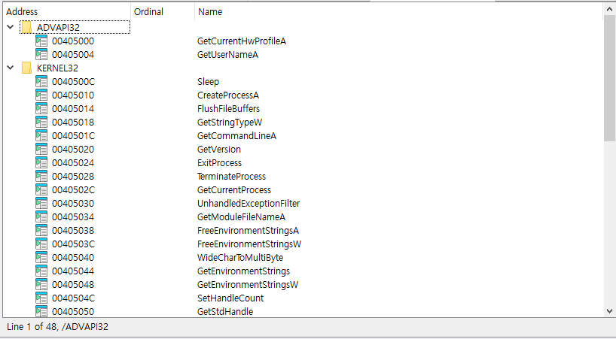
LAB 18-1
Can now view the program’s import and string

Slide 32
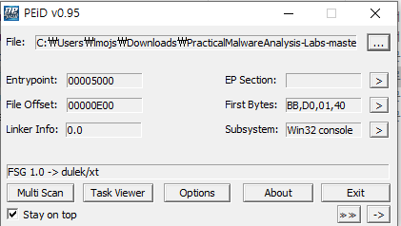
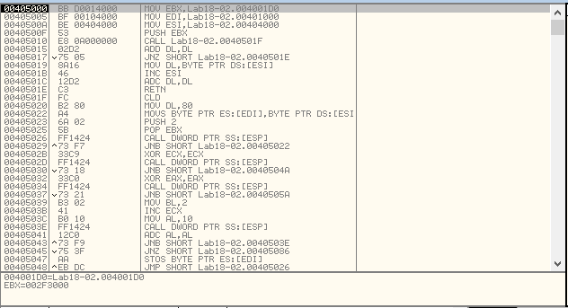
LAB 18-2
Unpack the Lab 18-02.exe
The program is packed by FSG1.0->dulek/xt

Slide 33
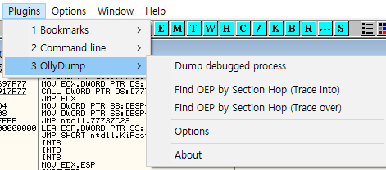
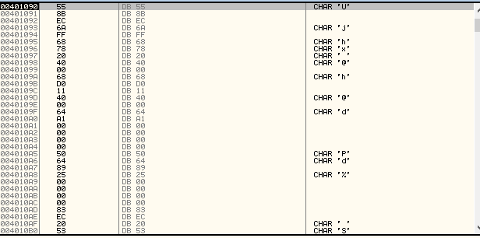
LAB 18-2
OllyDbg may not have disassembled this code
because it did not realize that it is code

Slide 34
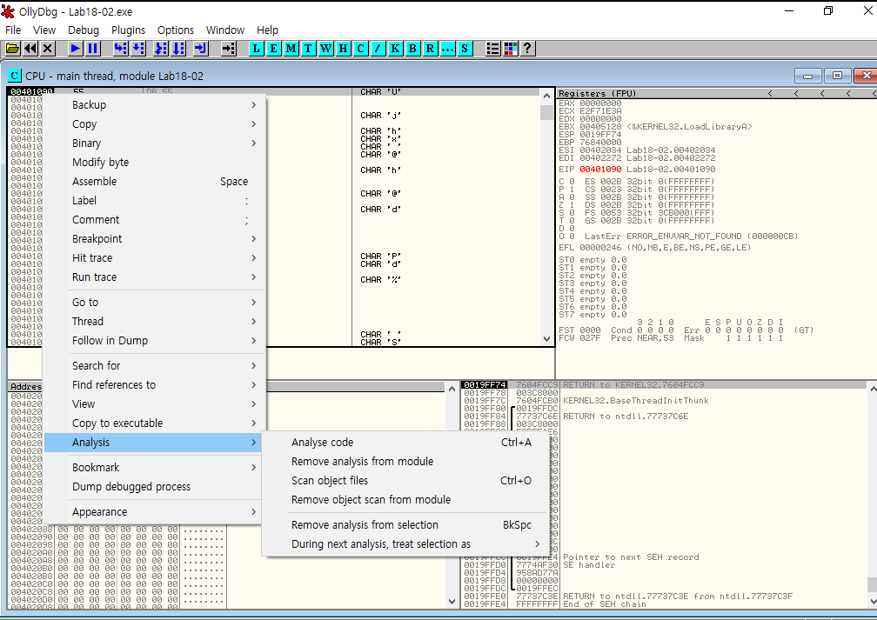
LAB 18-2

Slide 35
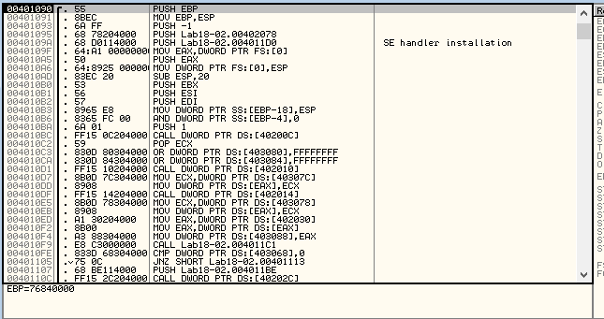

LAB 18-2

Slide 36
Thank You

